Slide 1
HUMAN COMPUTER INTERACTION
LECTURE 3

Slide 2
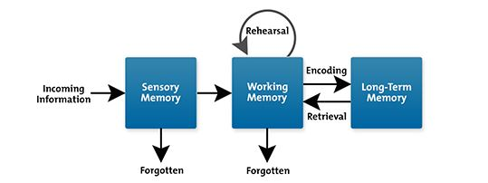
Human Memory:
There are three types of memory - sensory buffers, short-term memory, long-term memory

Slide 3
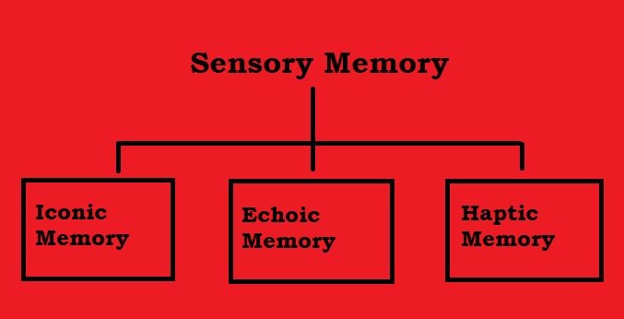
Sensory Memory – The sensory memory act as buffers for stimuli received through the sensors.
A sensory memory exists for each sensory channel. These memories are constantly overwritten by new information coming in on these channels.

Slide 4
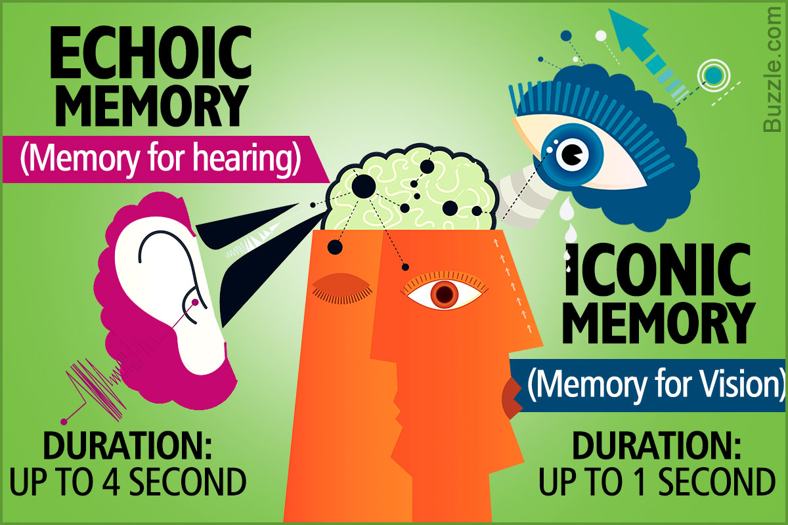
Information is passed from sensory memory into short-term memory by attention, thereby filtering the stimuli to only those which are of interest at a given time.
It is clear that we are able to focus our attention selectively, choosing to attend to one thing rather than other.
This is due to limited capacity of our sensory and mental process.

Slide 5

Short term memory - Short term memory or working memory acts as a ‘Scratch-pad’ for temporary recall of information.

Slide 6
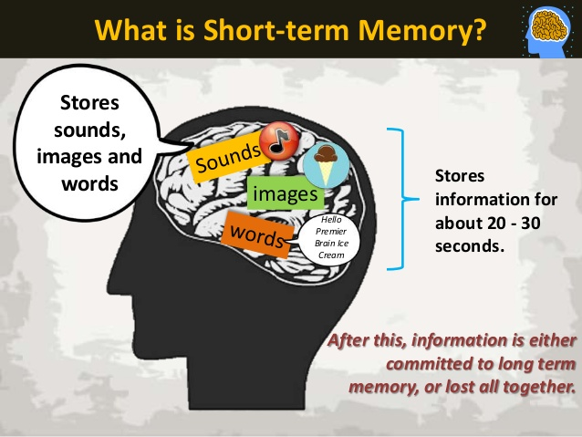
Short term memory can be accessed rapidly in the order of 70ms.However, it also decays rapidly in the order of 200ms.

Slide 7
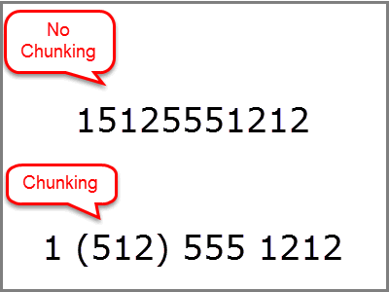
Chunking information can increase the short term memory capacity.
The limited capacity of Short term memory produces a subconscious desire to create chunks to optimize the use of memory.
The successful formation of a chunk is known as closure.

Slide 8
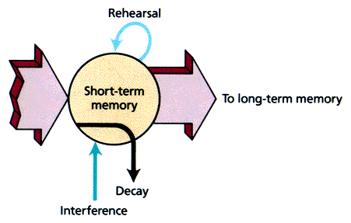
Short term memory recall is damaged by interference of other information but not necessarily.
Short term memory is not a unitary system but is made up of number of components, including a visual channel and articulatory channel.
Interference only occurs if tasks utilize the same channel.

Slide 9
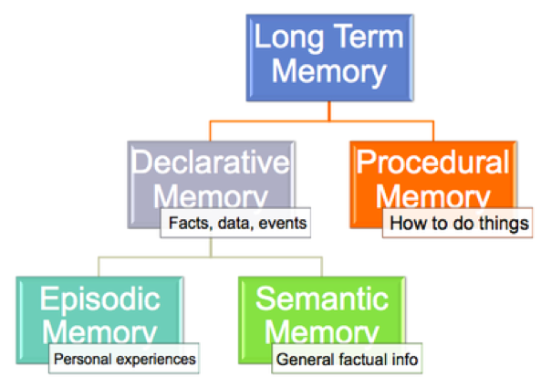
Long term memory – there are two types of long term memory- episodic memory and semantic memory.

Slide 10
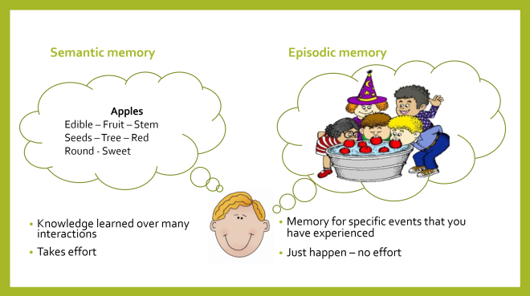
Episodic memory represents our memory of events and experiences in a serial form. It is from this memory that we can reconstruct the actual events that took place at a given point in our lives.

Slide 11
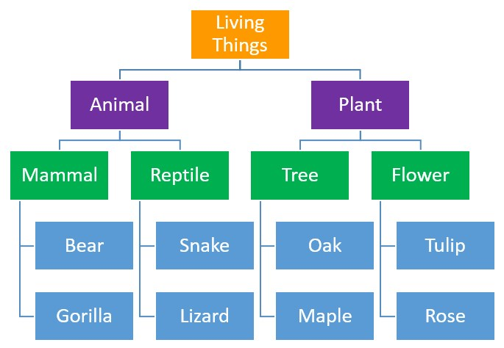
Semantic memory is a structured record of facts, concepts and skills that we have acquired. Semantic memory is structured in some way to allow access to information, representation of relationships between pieces of information and inference.
One model for the way in which semantic memory is structured is as a network. Items are associated to each other in classes, and may inherit attributes from parent classes.
This model is known as semantic network.

Slide 12
Thinking – Reasoning and Problem Solving:-
The process of how information is processed and manipulated in human is most complex and it is the one which separates human from other information processing systems.
When compared to other information processing system, humans are able to reason and solve problems even if the information is partial and unavailable.
We are able to think about things of which we have no experience and solve problems which we have never seen before.
Thinking can require different amounts of knowledge. Some thinking activities are very directed and knowledge required is constrained. Other requires vast amounts of knowledge from different domains.
There are two categories of thinking – Reasoning and Problem solving.

Slide 13
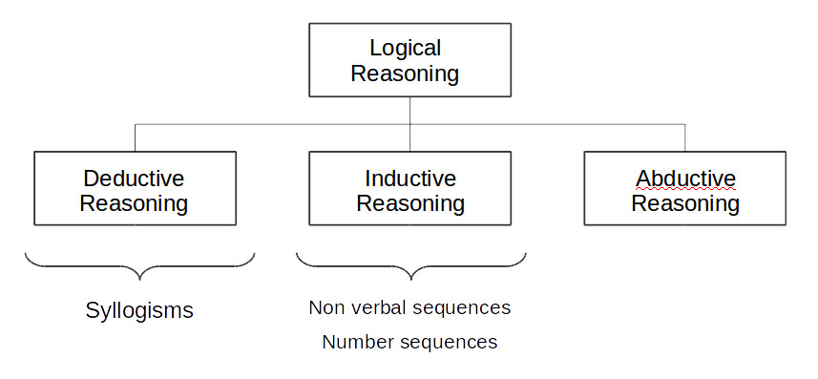
Reasoning: Reasoning is the process by which we use the knowledge we have to draw conclusions or infer something new about the domain of interest.
There are different types of reasoning – Deductive, Inductive, Abductive.

Slide 14
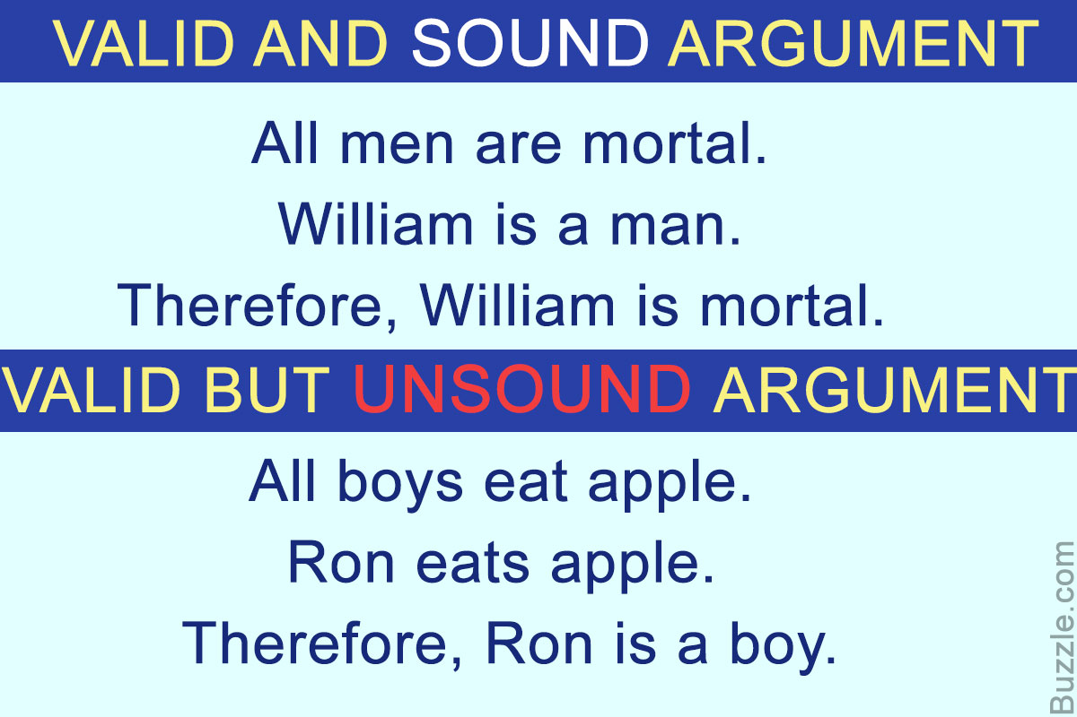
Deductive Reasoning: Deductive Reasoning drives the logically necessary conclusion from the given premises. It is important to note that this is the logical conclusion not necessarily have to be a truth.

Slide 15
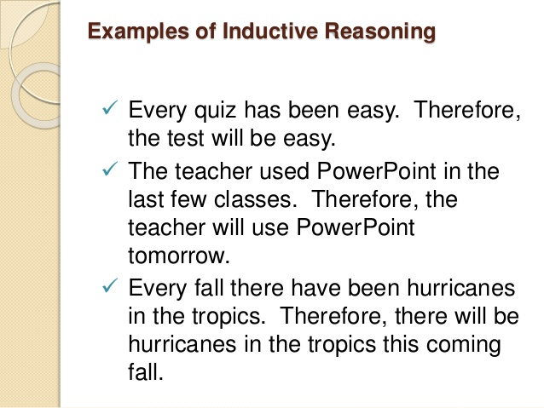
Inductive Reasoning: Induction is generalizing from cases we have seen to infer information about cases we have not seen. Induction is useful process, which we use constantly in learning about our environment.
‘

Slide 16
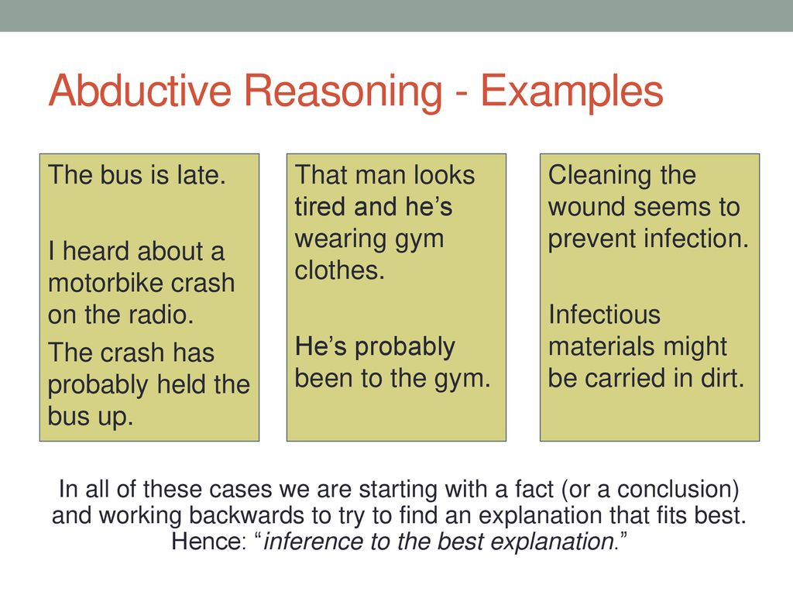
Abductive Reasoning: Abductive reasons from a fact to the action or state that caused it. This is the method we use to derive explanations for the events we observe. In spite of its unreliability it is clear that people do infer explanations in and hold on to them until they have evidence to support an alternative theory.

